Slide 1


Light particle searches at Belle
19th April 2010
Chao Liu
University of Science and Technology of China
(Belle Collaboration)

Slide 2
Contents
Belle Detector
Search for the X(1812)
  B± → K±ωφ
Search for a light pseudo-scalar particle
  B → K*⁰X⁰, X⁰(214) → μ⁺μ⁻
  B → ρ⁰X⁰, X⁰(214) → μ⁺μ⁻
Summary

Slide 3
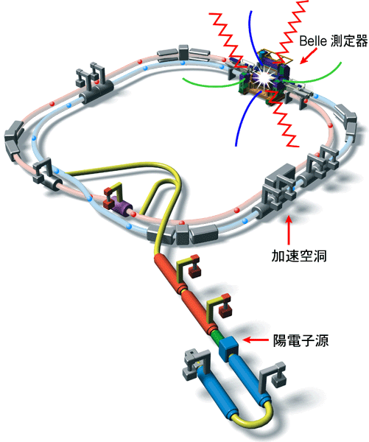
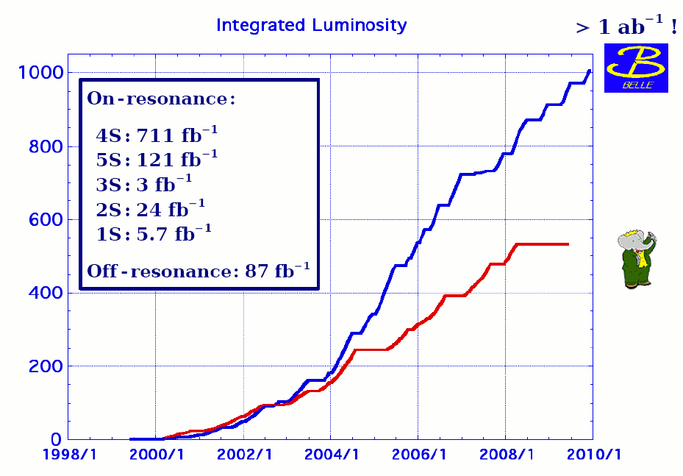
KEKB
CM Energy 10.58GeV
e⁺ 3.5 GeV
e⁻ 8.0 GeV
Belle detector
cavity
New World Record:
2.11×10³⁴cm⁻²sec⁻¹ was achieved
1.48fb⁻¹/day 8.01fb⁻¹/week
σ_{bb}: 1.05nb
σ_{qq}: 3.7nb
e⁺ source
Data Sample :
605 fb⁻¹ On Resonance
(711 fb⁻¹ reconstructed)
657 ×10⁶ BBar pairs

Slide 4
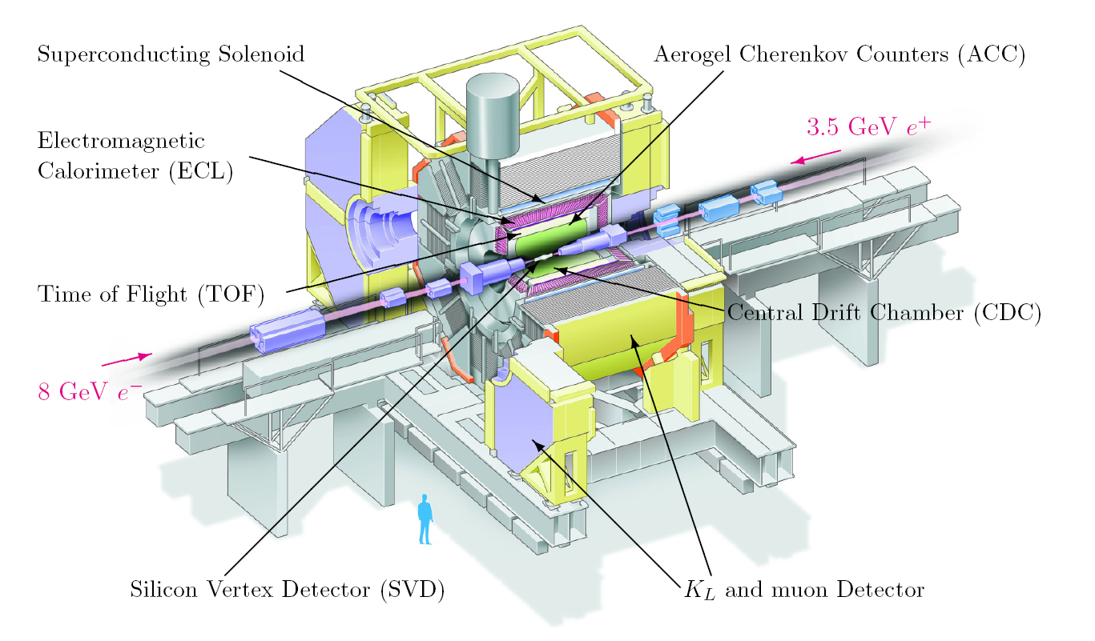
Belle Detector

Slide 5
Search for the X(1812) in B± → K±ωφ
Part Ⅰ
Publised in Phys. Rev. D 79, 071102 (2009)

Slide 6
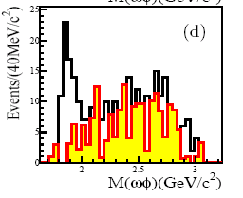
Near-threshold enhancement
BES found a near-threshold enhancement from the decay channel J/psi → γωφ :
M.Ablikim, PRL 96,162002(2006)
X(1812)

Slide 7
Speculation
Tetraquark state: B.A.Li, PRD 74,054017(2006)
Hybrid K.T.Chao,hep-ph/0602194
Glueball P.Bicudo, S.R.Cotanch, F.J.Llanes-Estrada and D.G.Robertson, Eur.Phys.J.C 52,363 (2007)
an effect due to intermediate meson rescatterings Q.Zhao and B.S.Zou, PRD 74,114025 (2006)
a threshold cusp attracting a resonance D.V.Bugg, J.Phys. G 35,075005 (2008)

Slide 8
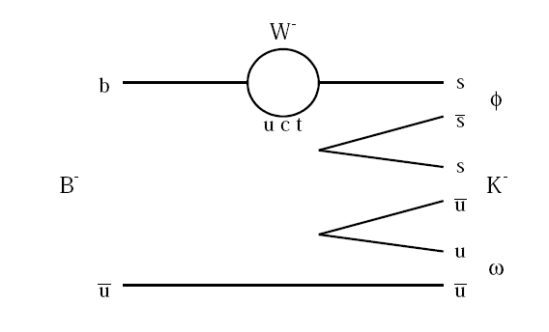
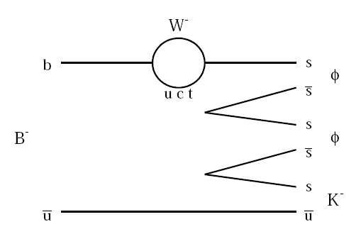
Motivation
Confirm whether X(1812) can be found in other decay channels.
Measurement of the B± → K±ωφ three-body decay is helpful for investigating decay mechanisms.
  A similar decay mode B± → K±φφ , has a rather large branching ratio
  B.Aubert, PRL,97,261803(2006)

Slide 9
Event Selection
φ→ K⁺K⁻
B → Kωφ
ω→ π⁺π⁻π⁰
π⁰: 0.1193<M_{γγ} < 0.1477 GeV/c² ,
|P _{π}0 |_{lab} >0.38 GeV/c
ω: |M_{π+π-π0}-M_{ω}|< 0.03 GeV/c²
φ: |M_{K+K-}-M_{φ}|< 0.02 GeV/c²,
|P_{K}|_{CM}<1.5Gev/c

Slide 10
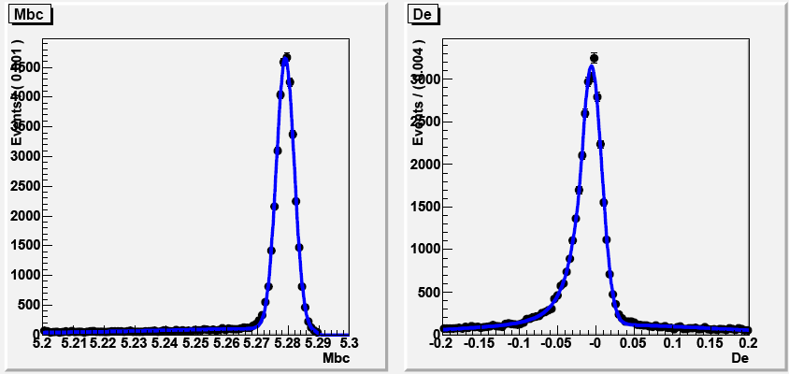
Kinematic variables, ΔE and M_{bc}
Kinematic variables, ΔE and M_{bc}
  ΔE = E_{B}* - E_{beam}*
  (M_{bc})² = (M_{ES})² = (E_{beam}*)² - |p_{B}*|²
  E_{beam}* : beam energy, p_{B}* and E_{B}* : momentum and energy of B candidate
  GeV/c² <M_{bc} <5.29 GeV/c^{2,} -0.2 GeV<ΔE<0.2 GeV , 5.20

Slide 11
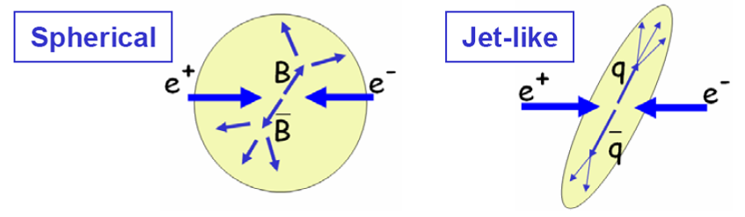
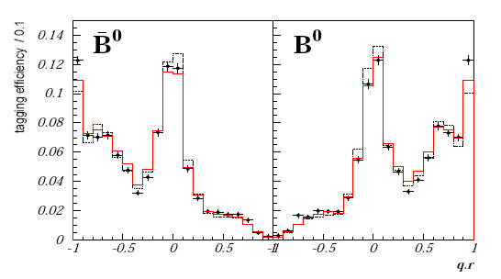
Continuum Suppression
Continuum suppression with event topology variables
Belle b-flavor tagging algorithm
  flavor of the tagged
  meson q (±1).
  flavor tagging quality factor
  r (0~1).
Hamlet: To B, or not to B,
that is the question

Slide 12
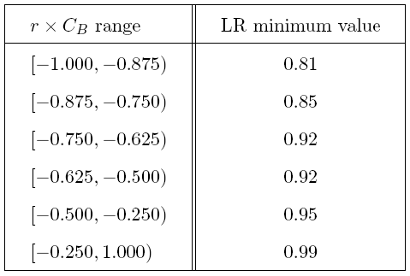
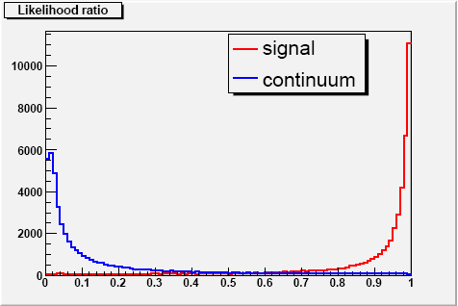
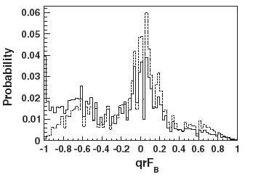
Background Study
Combine events topology variables into a fisher discriminate
Further suppression is achieved using b-flavor tagging information.
dashed line: qqbar
solid line: signal
preserve 57.9% signal
reject 98.6% continuum background

Slide 13
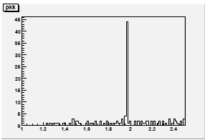
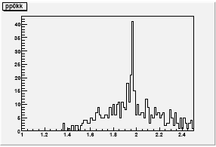
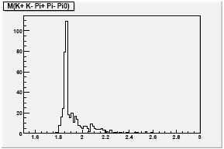
BBbar Background
Charmed B (b→c) decay
  |M_{πK+K-} -M_{Ds}| > 0.15GeV/c²
  |M_{π0πK+K-}M_{Ds}|>0.15GeV/c²
  M_{π+π-π0K+K-} >2.2GeV/c²
Charmless B decay is negligible

Slide 14
Result
4D extended unbinned ML fit is performed 605fb⁻¹
signal
qqbar
BBbar
total
signal region:
-0.15 GeV<ΔE<0.05 GeV
5.27 GeV/c² <M_{bc} <5.29 GeV/c²
signal yield :
branch ratio of B± → K±ωφ :
@90%C.L

Slide 15
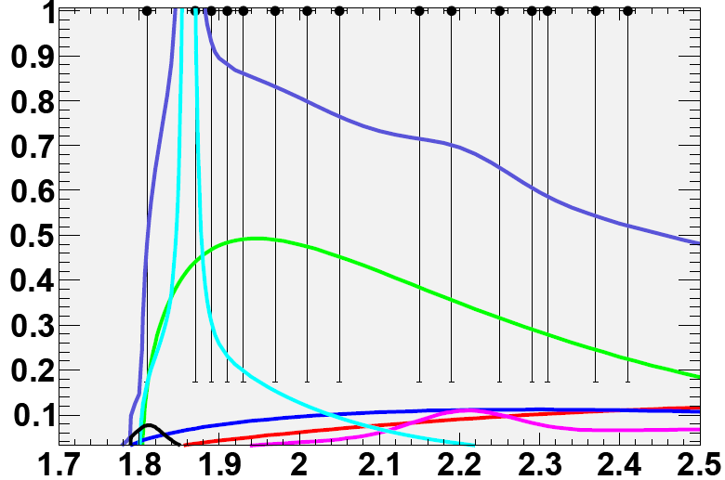
Result
NO significant signal is observed in ωφ mass spectrum
B→Kωφ
X
qqbar
BBbar
D⁰
D_{s}
total
Do not use D⁰ and D_{s} mass veto to exclude D⁰ and D_{s} background
X(1812) yield :
Systematic error: +34.4%
-27.1%
@90%C.L

Slide 16
  Search for a light pseudo-scalar particle
  X⁰(214) → μ⁺μ⁻
Part Ⅱ

Slide 17
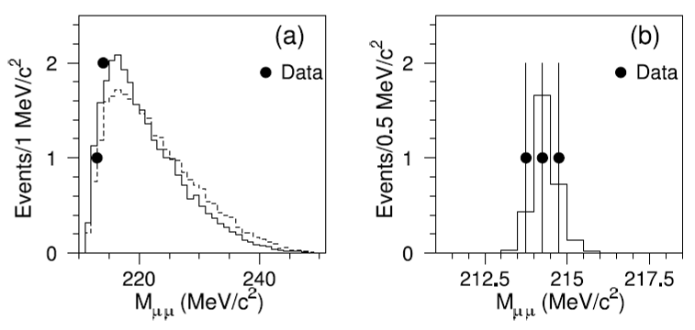
HyperCP Exotic Events
  Observation of 3 events for Σ⁺ → p μ⁺μ⁻ decays
  H.K.Park et al. (HyperCP Collaboration), PRL 94, 021801 (2005)
Property of X⁰(214)
  mass : 214.3 ±0.5 MeV/c²
  Pseudo-scalar or axial-vector
Possible interpretations
  Sgoldstino (pseudo-scalar)
  D.S.Gorbunov and V.A.Rubakov, PRD 73, 035002 (2006)
  Low mass Higgs
  X.-G.He, J.Tandean and G.Valencia, PRL 98, 081802 (2007)

Slide 18
Possible Decay Modes for Further Search at B-Factory
Possible decay modes for further search as sgoldstino in GMSB (Gauge Mediated SUSY Breaking)
  Pseudo-scalar B and D meson decays to pseudo-scalar meson and X⁰
    D → π π X⁰, X⁰ → μ⁺μ⁻, γγ
    B → K π X⁰, X⁰ → μ⁺μ⁻, γγ
  Pseudo-scalar B and D meson decays to vector meson and X⁰
  S.V.Demidov and D.S.Gorbunov, JETP Letters, 2006, vol. 84, No. 9, pp479-484
    B(D → ρ X⁰, X⁰ → μ⁺μ⁻) = 10⁻⁹ ~ 10⁻⁶
    B(B → K* X⁰, X⁰ → μ⁺μ⁻) = 10⁻⁹ ~ 10⁻⁶
    B(B → ρ X⁰, X⁰ → μ⁺μ⁻) = 10⁻⁹ ~ 10⁻⁶
The listed channels above are possible for low mass Higgs search in NMSSM (Next-to-Minimal SUSY SM)

Slide 19
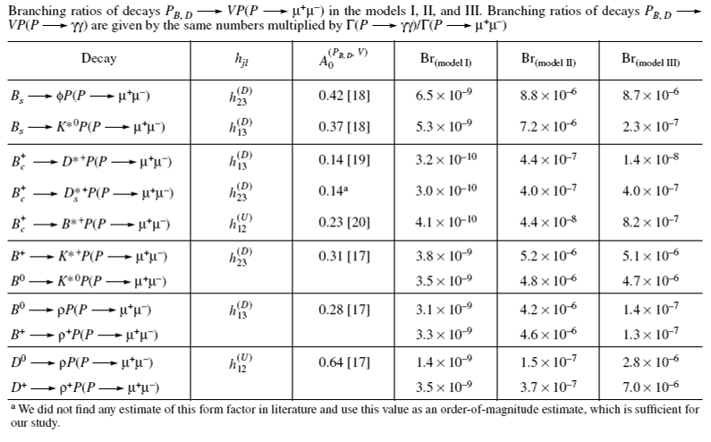
Expected BR as sgoldstino
S.V.Demidov and D.S.Gorbunov, JETP Letters, 2006, vol. 84, No. 9, pp479-484

Slide 20
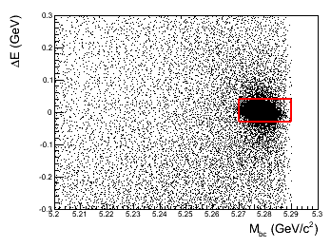
Event selection and Signal efficiency
preliminary
B → K*⁰X⁰, K*⁰ → K⁺π⁻, X⁰ → μ⁺μ⁻
B → ρ⁰X⁰, ρ⁰ → π⁺π⁻, X⁰ → μ⁺μ⁻
Invariant masses of K*⁰ and ρ⁰ :
central value of the fitted ± 1.5Γ and ± 1Γ, respectively
Kinematic variables, ΔE
and M_{bc}, cut applied
X⁰ window defined with dimuon mass resolution
214.3 ± 3 × (0.5 (HyperCP) + resol. (Belle)) [MeV/c²]
211.5 MeV/c² < M_{μ+μ-} < 217.1 MeV/c²
Decay mode | Dimuon mass resolution [keV/c²] | Signal efficiency (ε)
B → K*⁰X⁰ | 427 ± 14 | (26.3 ± 0.1)%
B → ρ⁰X⁰ | 428 ± 15 | (23.5 ± 0.1)%

Slide 21
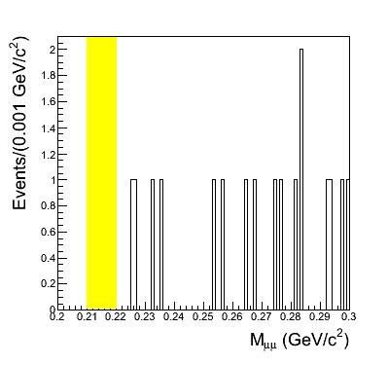
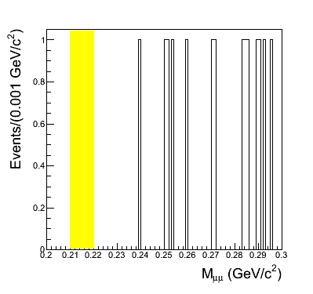
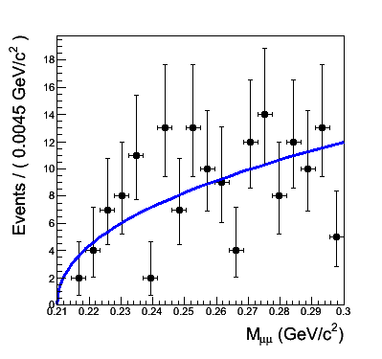
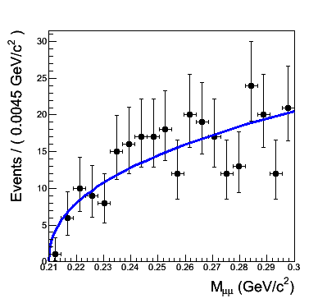
Background Study
preliminary
Counting method
  Use MC samples of continuum and BB-bar which are larger than data sample
- Shaded region is X⁰ window
B → K*⁰X⁰
B → ρ⁰X⁰
Decay mode | Fitting the sidebands | Counting
B → K*⁰X⁰ | 0.13^{+0.04}_{-0.03} | 0
B → ρ⁰X⁰ | 0.11^{+0.03}_{-0.02} | 0
Fitting method
  Fit MC data in sideband region (sideband is defined as 5σ ~ 10σ in ΔE-M_{bc})
B → K*⁰X⁰
B → ρ⁰X⁰

Slide 22
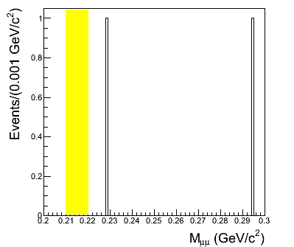
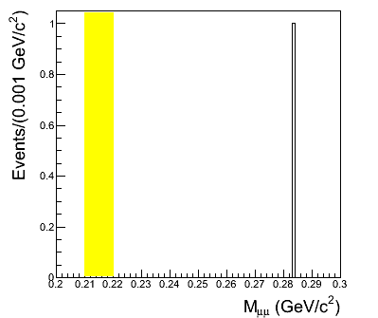
Systematic and Upper limit
preliminary
No event is observed in the signal region for each mode with 657M BB-bar data
B → K*⁰X⁰
B → ρ⁰X⁰
New results
The upper limits @ 90% C.L. are calculated
  B(B⁰ → K*⁰ X⁰, K*⁰ → K⁺ π⁻ and X⁰ → μ⁺ μ⁻ ) < 2.2 × 10⁻⁸
  B(B⁰ → ρ⁰ X⁰ , ρ⁰ → π⁻ π⁺ and X⁰ → μ⁺ μ⁻ ) < 1.7 × 10⁻⁸
Our result rules out most of allowed BR for sgoldstino interpretation (will study U.L. as function of lifetime)

Slide 23
Summary
Search for the X(1812) in B± → K±ωφ
  No significant signal is observed in ωφ mass spectrum
  The obtained upper limits @ 90% C.L. are as follows :
    Br(B± → K±ωφ) <1.9×10⁻⁶
    Br(B± → K±X(1812),X(1812) → ωφ) <3.2×10⁻⁷
Search for a light pseudo-scalar particle X(214)
  No event is observed in B decays
  The obtained upper limits @ 90% C.L. are as follows :
    B(B⁰ → K*⁰ X⁰, K*⁰ → K⁺π⁻ and X⁰ → μ⁺μ⁻ ) < 2.0 × 10⁻⁸
    B(B⁰ → ρ⁰ X⁰ , ρ⁰ → π⁻π⁺ and X⁰ → μ⁺μ⁻ ) < 1.5 × 10⁻⁸

Slide 24
Thank you

