Slide 1
Status of the LHCb Experiment
杨振伟
Tsinghua Group on LHCb
2010高能物理学术年会
2010.04.18

Slide 2
Outline
LHCb introduction
Status of LHCb Experiment
  Running Summary
  Recent Results
Physics Analysis by Tsinghua Group
Summary

Slide 3
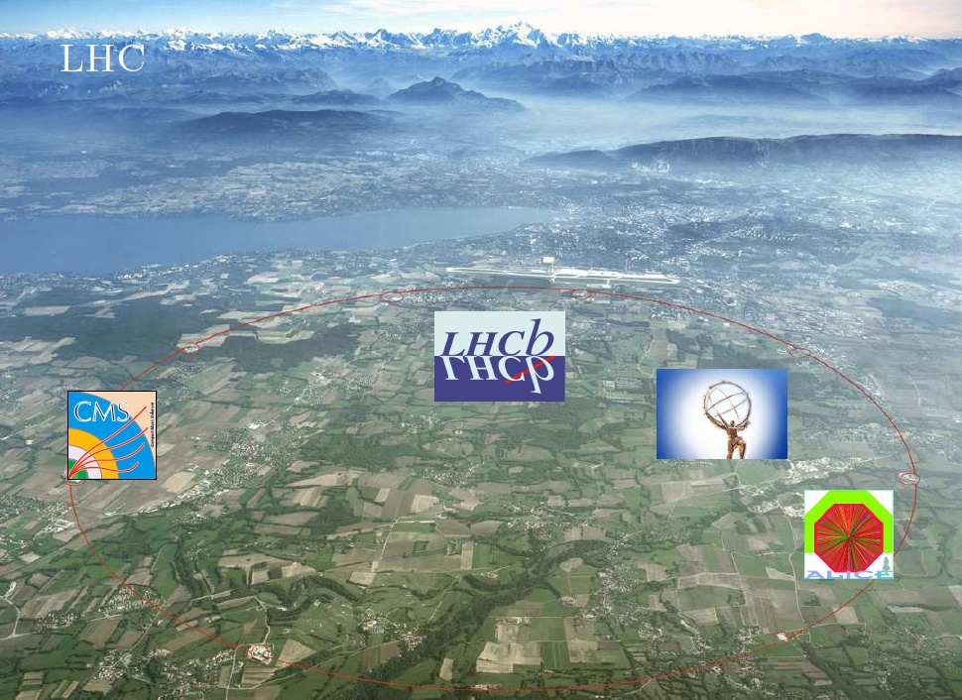
➢ Success running in 2009 @ 2.36 TeV
➢ Beam energy Ramping to 3.5 TeV on March 19
➢ first collision @ 7 TeV on March 30

Slide 4
The LHCb Collaboration
~800 physicists
54 institutes
15 countries
  North America: 1(US)
  South America: 1(Brazil)
  Asia: 1(China)
Main goal: CP violation & rare decay →New Physics

Slide 5
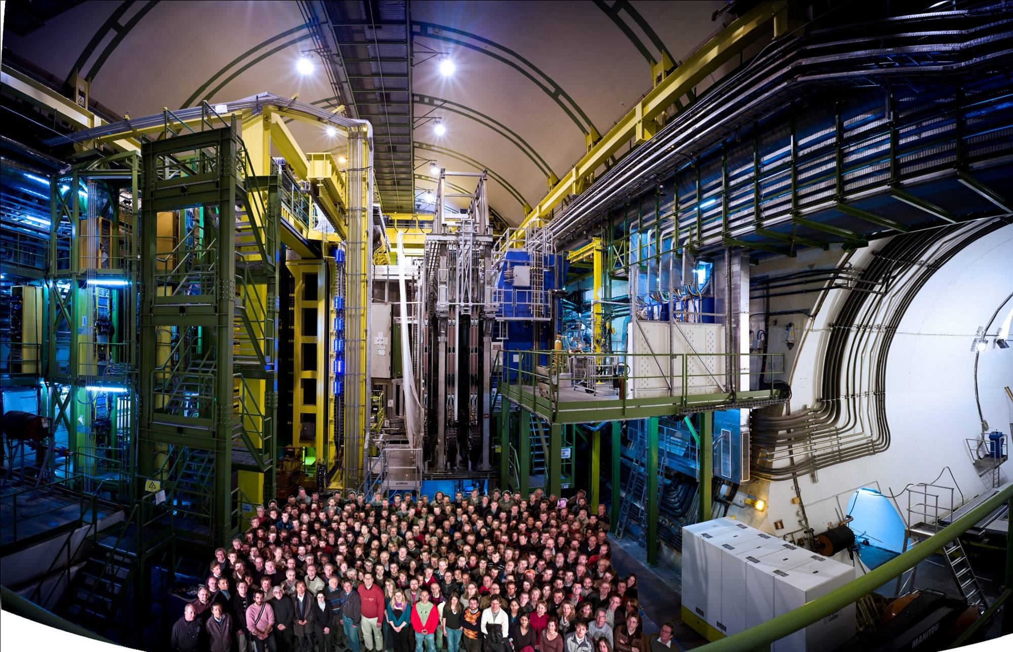


Slide 6
Physics on LHCb
New Physics
1. CP violation
2. rare decay
……
Flavor Physics (b Physics and c Physics)
1. J/Ψ production(prompt and from b-decay)
2. B_{c} physics
3. Upsilon
4. b Baryons (Λ_{b},…)
……

Slide 7


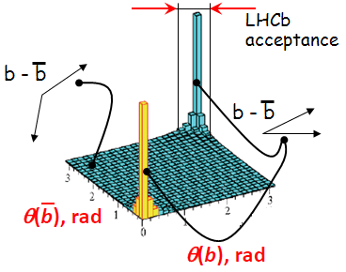
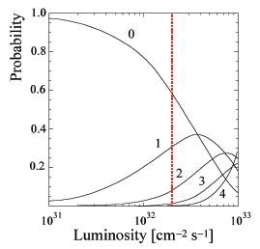
b production on LHC(b)
bb pair production correlated, sharply peaked forward-backward
  bb cross-section : σ_{bb} ~ 500 µb (@14 TeV)
  B^{+/-} (40%), B⁰ (40%), B_{s} (10%), b-baryons (10%), B_{c} (< 0.1%)
LHCb limits luminosity to few 10³² cm⁻²s⁻¹ to reduce pile-up
  Maximize probability of a single interaction per crossing
  Design luminosity soon after start-up
~2fb⁻¹ per year
~ 10¹² bb per year

Slide 8
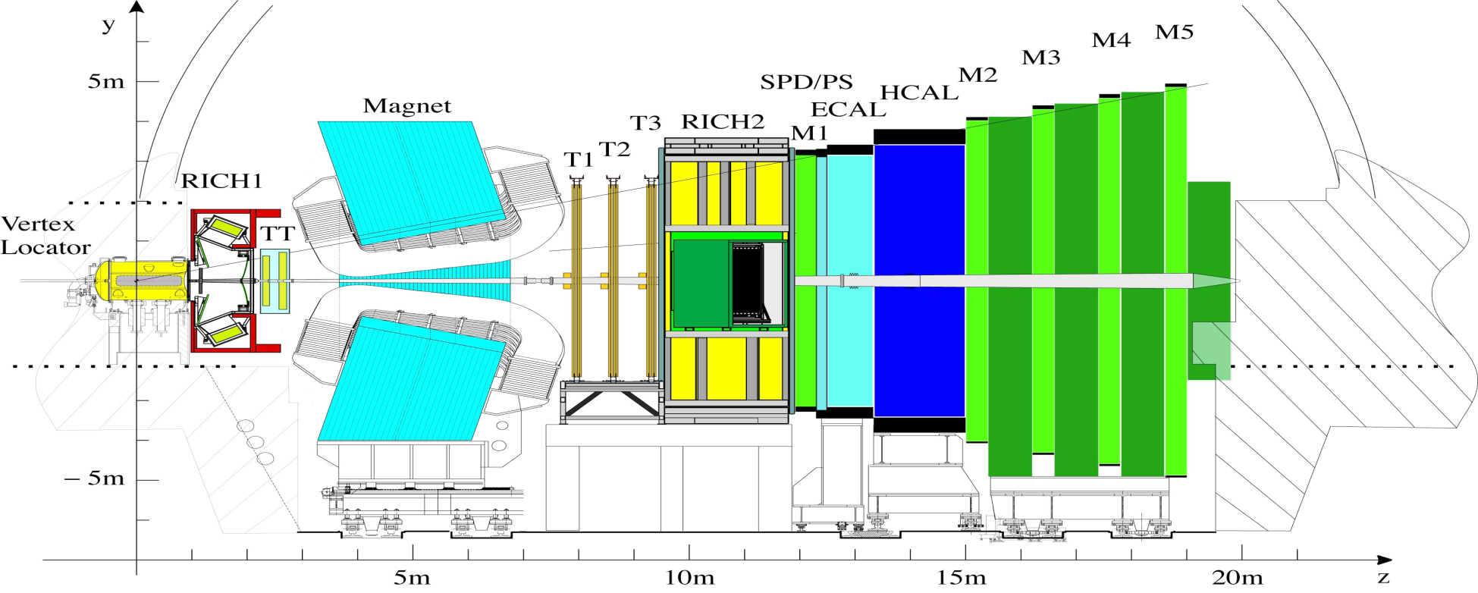
LHCb Detector (1)
μ⁺
beam 1
beam 2
b hadron
μ⁻
Silicon strip detector:
σx/y ~ 10 μm
σz ~ 60 μm
Tracking System (TT,T1-T3):
Tracking Efficiency ~ 95%
Ghost ~ 5%
Δp/p~ 0.5%(long tracks)
*long tracks: tracks passing trough VELO,TT,T1-T3

Slide 9
LHCb Detector (2)
μ⁺
beam 1
beam 2
b hadron
μ⁻
Muon System (M1-M5):
μ-id： ε(μ→μ) ~94 %,
mis-id: ε (π→μ) ~ 3 %
RICH1&RICH2
π/K id：ε(Κ→Κ) ~95 %，
mis-id ~5% ，
ECAL: σ(E)/E= 10% E^{-1/2} ⊕ 1 % (E in GeV)
HCAL: σ(E)/E= (69+/-5)% E^{-1/2} ⊕ (9+/-2) % (E in GeV)

Slide 10
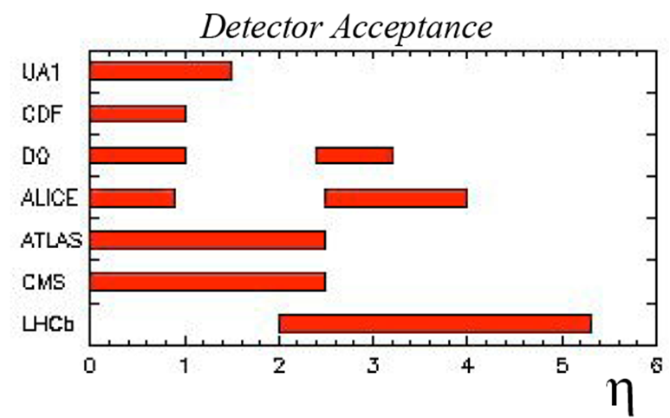
Unique accept. of LHCb

Slide 11
LHCb Status
First Run in 2009 at
  accumulated
  commissioning, alignment, calibration…
  π⁰, φ, K_{s}, Λ
2010 Run at
  successful start
  accumulated (up to 16 April)
  First signals of K*, φ, Ξ, D, J/Ψ, …
  Velo fully colsed

Slide 12
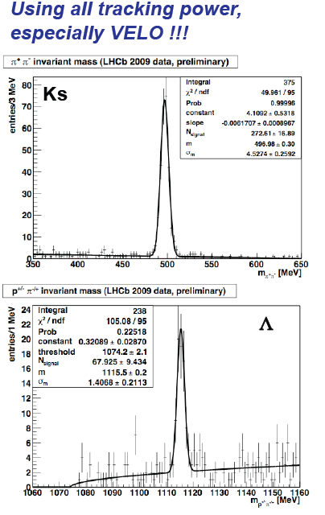
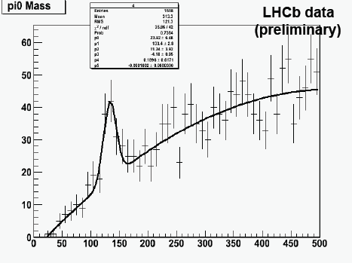

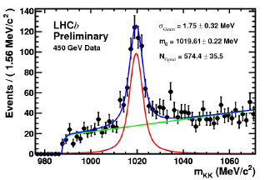
LHCb Data (900GeV)

Slide 13
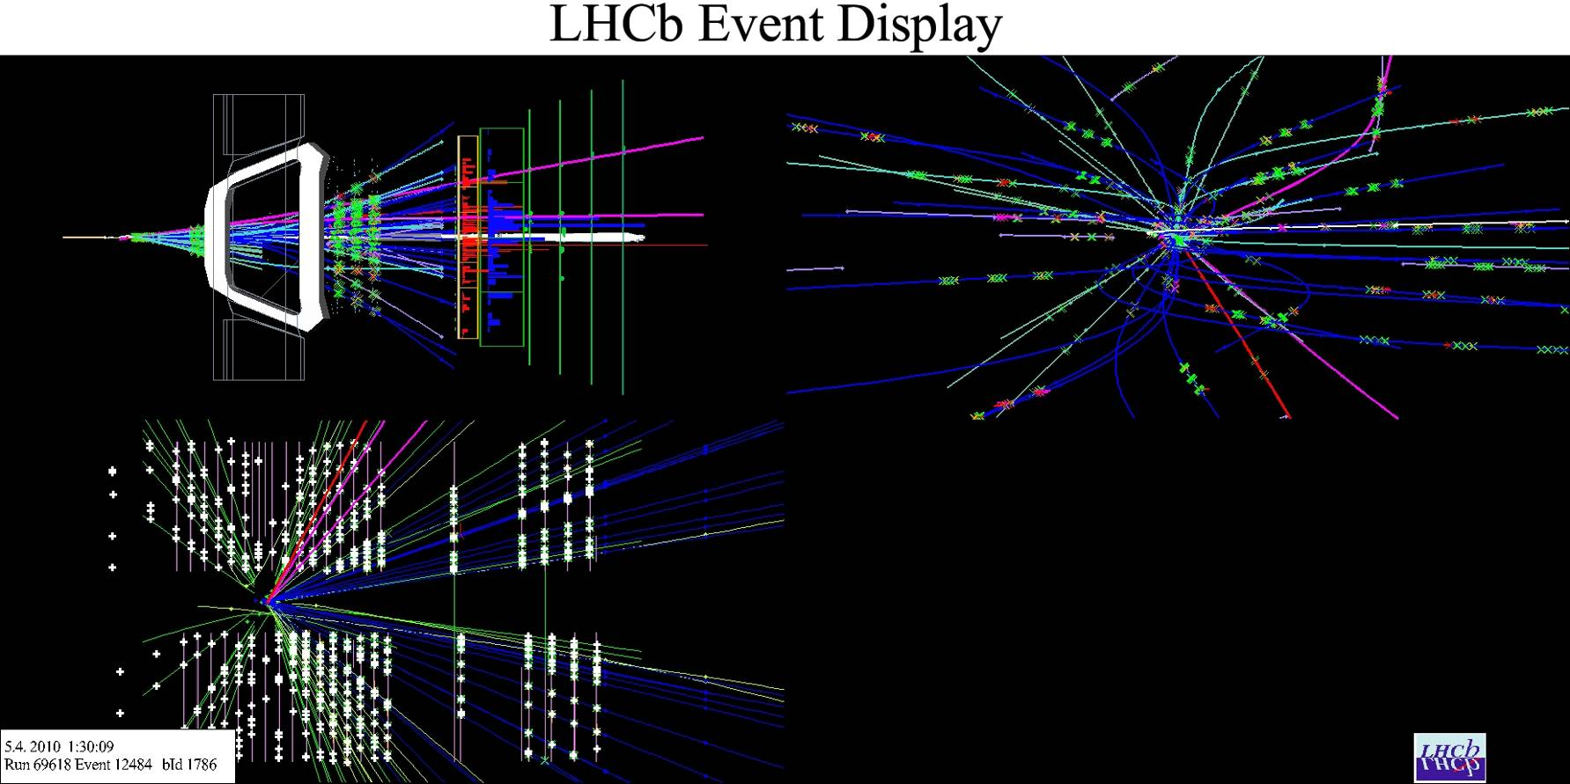
LHCb Data (7TeV)
K*, Ξ, D⁰ , D⁺, D_{s}, D*, J/Ψ , … reconstructed
B→J/ψK candidate: global view
(muons are magenta, kaon is red)

Slide 14
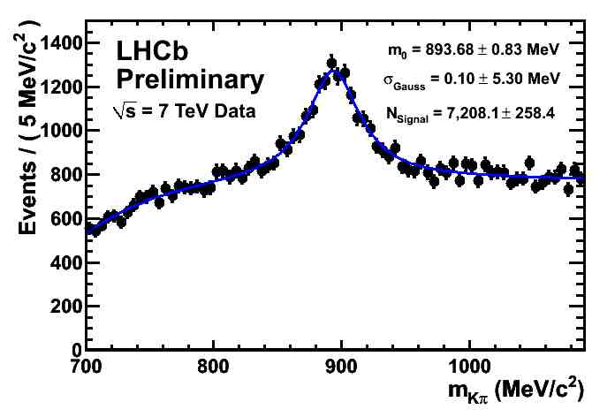
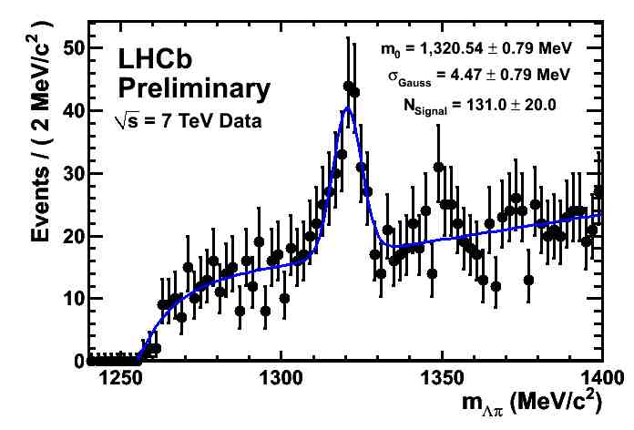
2010 Preliminary (1)

Slide 15
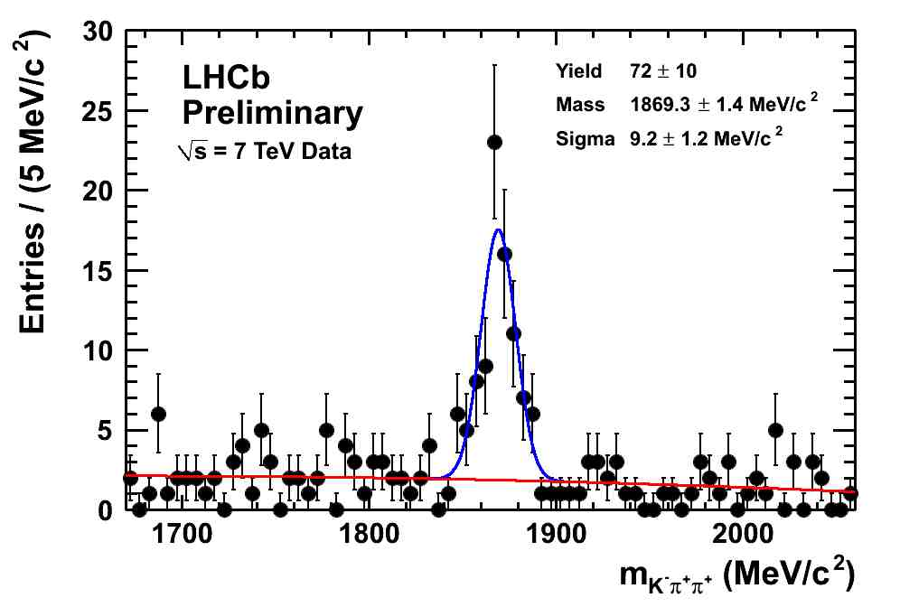
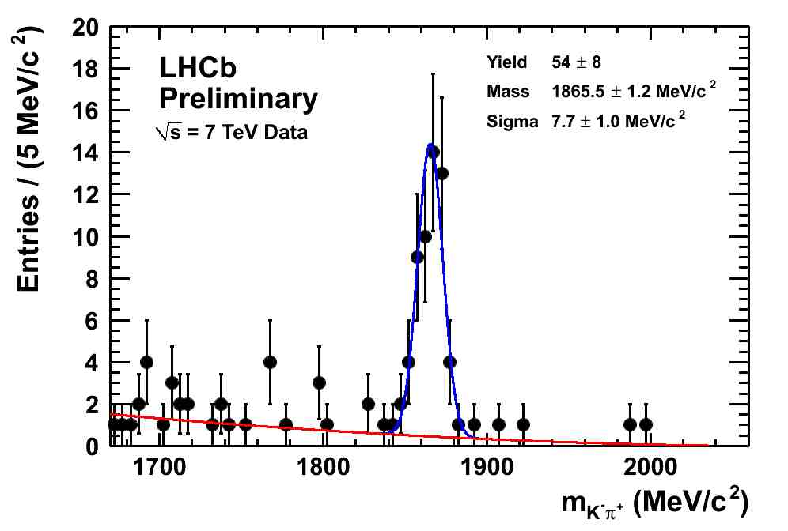
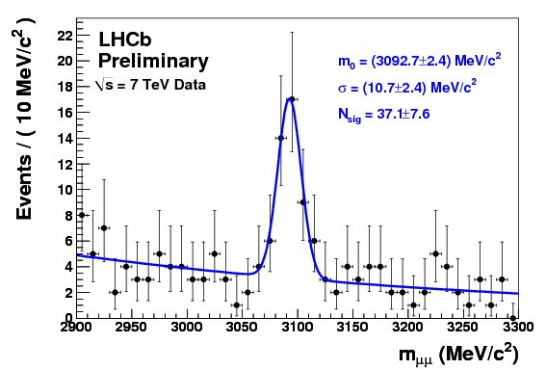
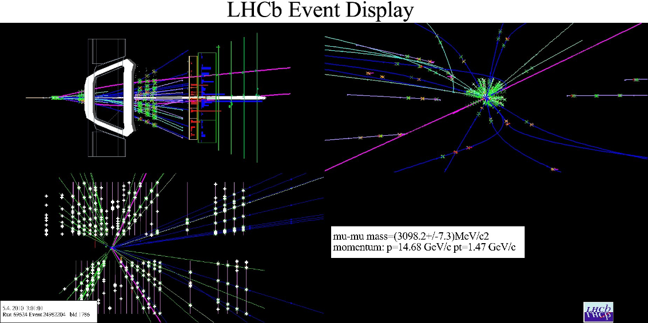
2010 Preliminary (2)

Slide 16
Analysis in Tsinghua
V0 systematic error study
J/Ψ production
  Cross section measurement
  Polarization measurement
Bc Physics
Upsilon production
MC studies: 3 public notes
LHCb-PUB-2010-011,
CERN-LHCb-2008-059, CERN-LHCb-2008-077
Conference talks

Slide 17
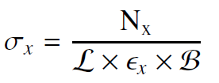
J/psi cross section measurement

Slide 18
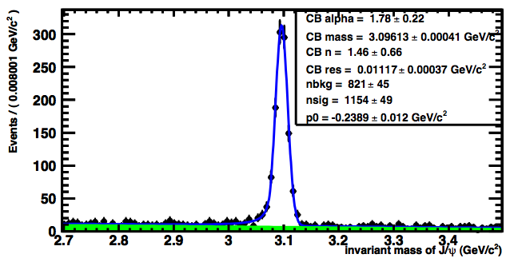
J/Ψ Selection (MC)
μ tracks:
● long tracks
● hits in muon-det. (fun. of p)
● Combined PID > -1
● pT > 0.7 GeV/c
● Track quality (χ²/nDoF < 2)
Reconstructed J/ψ:
● Mass window: 0.4 GeV/c²
● vertex fit quality (χ²/nDoF <6)
Event selection:
● At least one PV
● Remove Clones
➢ mass resolution (σ): 11.1±0.4 MeV/c²
➢ S/B in 3σ range: 17.6 ±2.3
➢ 5 pb⁻¹ @ 7 TeV: ~ 3.2 × 10⁶ J/ψ rec.

Slide 19
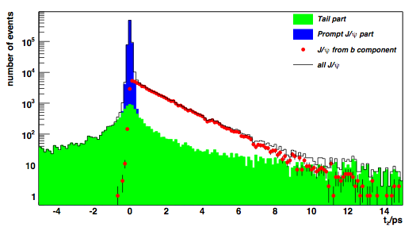
t distribution
Four components to the t distribution
Prompt component
Gaussian
J/ψ from b Exponential
Prompt background
[extract from
mass sidebands]
μ⁺
μ⁻
Long tail due to association of wrong primary vertex
[Measure using the J/ψ vertex and the PV in different event]
dz
Primary vertex

Slide 20
Fit Strategy
➢ J/ψ divided into 28 bins in phase space
7 bins for 0<p_{T} <7GeV
4 bins for 3<η<5
➢ For each bin:
☞ Combined mass lifetime fit
to extract prompt J/ψ and J/ψ from b decay
☞ Corrected with efficiency
➢ Get the cross section

Slide 21
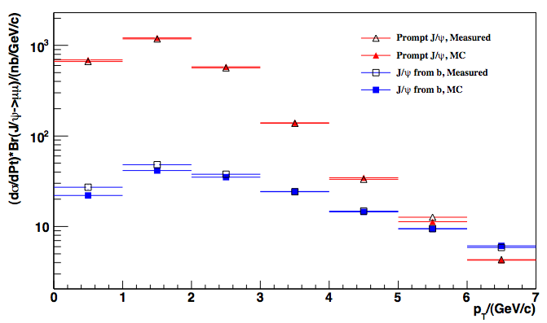
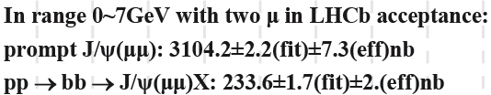

Cross-section Results
Input:

Slide 22
Error Estimation
➣ Statistical error <10% per Pt and η bin with 5 pb⁻¹ @ 7 TeV
➣ Error on luminosity: ~10%
➣ Error on Br(b->J/ψX): ~9%
➣ Error on fit: ~ 2%
➣ Need real data to understand tracking, muon PID,
vertexing, etc.

Slide 23
J/Ψ polarization measurement

Slide 24
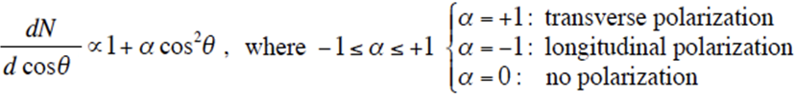
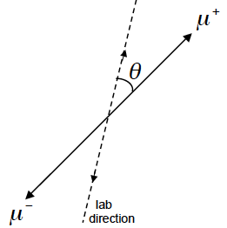
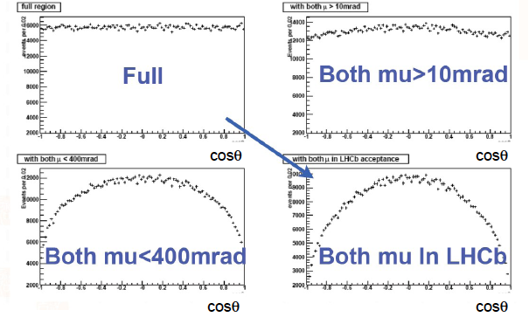
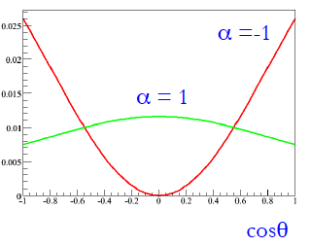
Polarization Dependence
➣ LHCb geometry induces fake J/ψ polarization
➣ Reconstruction efficiency also depends on polarization

Slide 25
Measurment strategy
done in 28 bins of different phase space
7 bins for 0<p_{T} <7GeV
4 bins for 3<η<5
Acceptance vs. cosθ at each bin estimated by MC
3-D combined fit in tz, cosθ and M^{J/ψ}
Results of polarization is finalizing(MC), notes in preparation

Slide 26
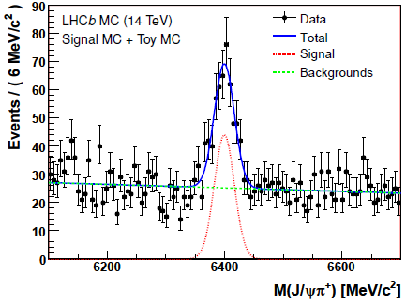
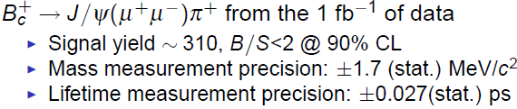
B_{c} Physics
Study of B_{c}→J/ΨμX is ongoing.

Slide 27
Summary
LHCb Detector Running successfully
1) V0 analysis (900GeV) will be finished
2) Charmonium analysis (7TeV) started
lots of charmonium particles reconstructed
Tsinghua group’s work, focusing on
1) V0 analysis (for systematic errors)
2) J/Ψ production
3) B_{c} study

Slide 28
Thank you!

Slide 29
Backup Slides

Slide 30
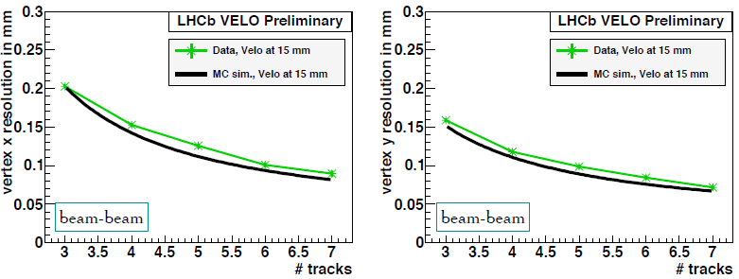
VELO Vertex resolution
Excellent agreement between data and MC

Slide 31
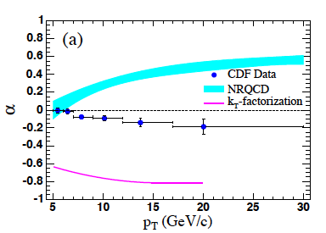
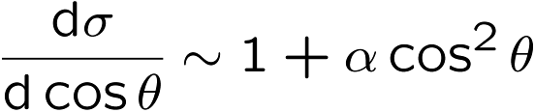
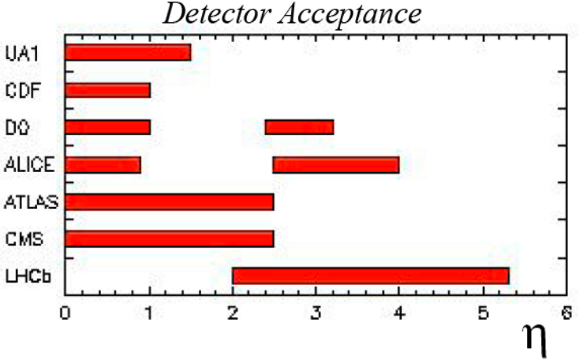
Prompt J/ψ production
The long history of cross-section/polarisation measurements and theoretical calculations: Still not so satisfactory
Advantages at LHC and LHCb:
Higher Energy, larger η
→Interesting phys. for the first 5pb⁻¹ data
Important for later analysis: muon trigger, branching ratios etc
CDF PRD71, 032001 (2005)
θ Measured in J/ψ cms frame
J/ψ
Notes:
Definition of \alpha

Slide 32
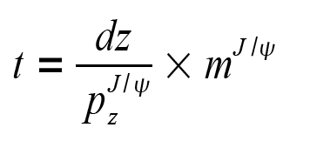
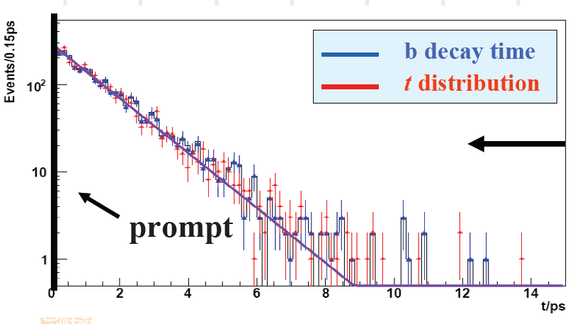
Identifying prompt J/ψ
Expect ~8% J/ψ from b decays
To separate J/ψ from prompt and b decays:
μ⁺
μ⁻
dz
Primary vertex
True b quark lifetime
t distribution
Simple approximation of b quark proper time
Generator level
Notes:
8%, which pt?

Slide 33

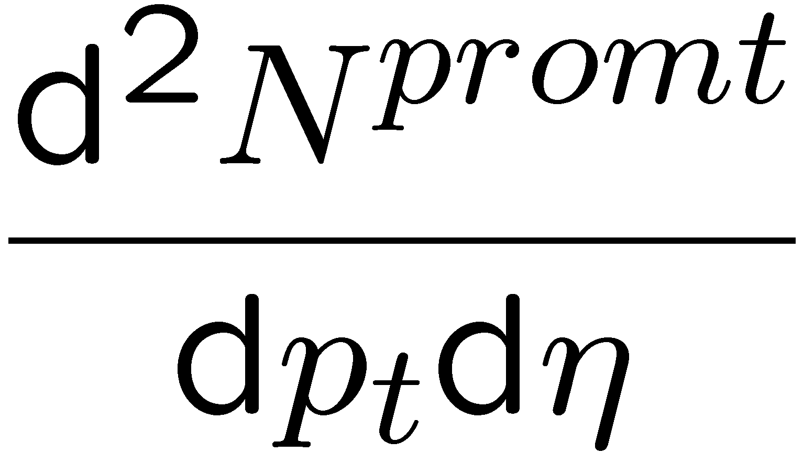
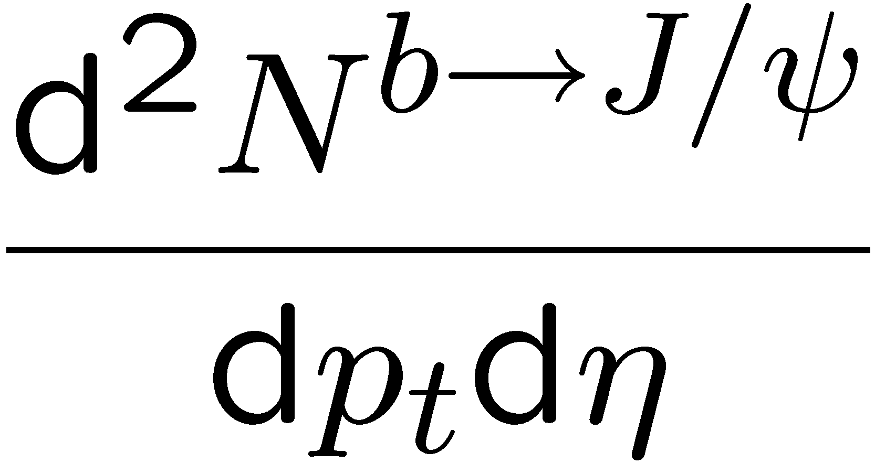

Analysis Strategy
Measurement in bins of p_{t} and η
→ reduce model dependence on
Acceptance vs. cosθ at each bin estimated by MC
At each bin, perform a joint fit to (M^{J/ψ}, t, cosθ)
So we simultaneously measure
easy transformations to other ref. frames
Cross Sections
Polarisation

Slide 34
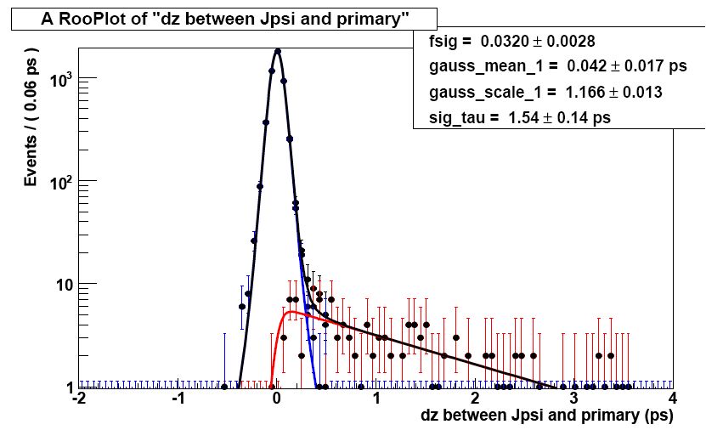
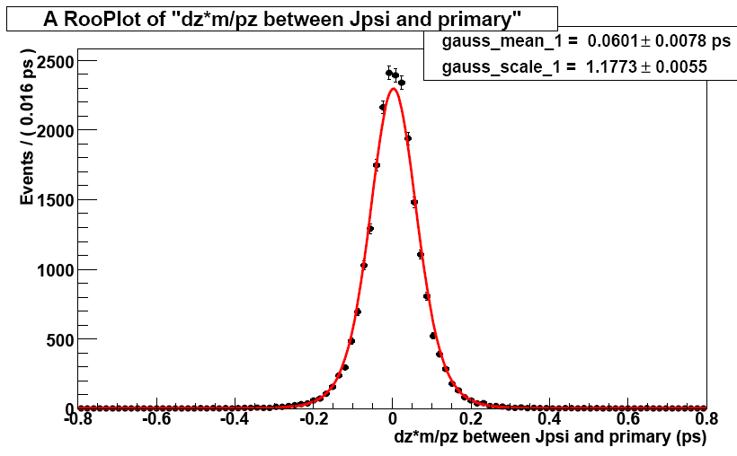

Combined Fit Function:Signal Fit
t/ps
t/ps

Slide 35


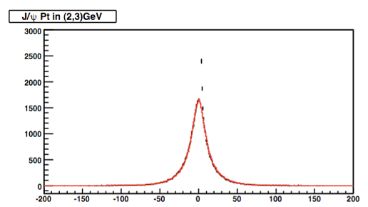
Method for Tail Function
➣ Tail distribution could be got from Real data
➣ Using J/ψ vertex and primary vertex in the next events
Estimated t

Slide 36
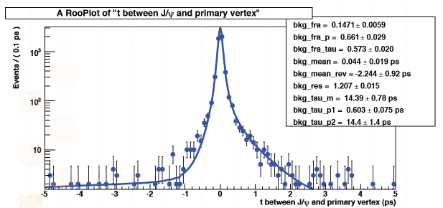
Combined Fit Function:Background Fit
➣ Could be determined from mass sidebands
➣ For current study, background are generated by toy MC using sidebands of Mini-bias sample passing L0 trigger

Slide 37
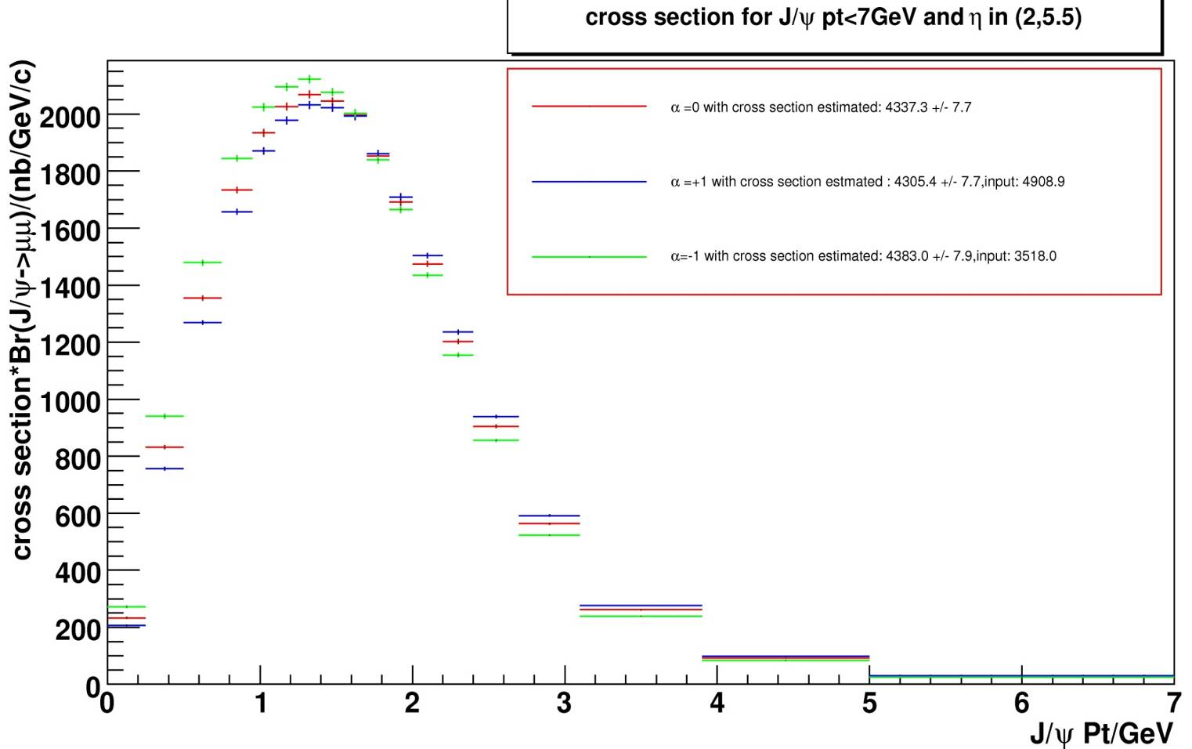
Polarisation Effect on Measurement
With the same number of selected J/ψ
12%
25%
Shape Changed
Slightly different due to efficiency
➣ The total cross section difference may be up to 25%
➣ The differential cross section shape may be changed
➣ For some pt and η bins, the effect is much larger than average

Slide 38
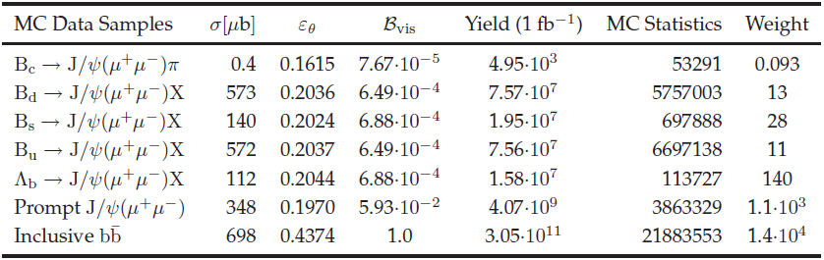
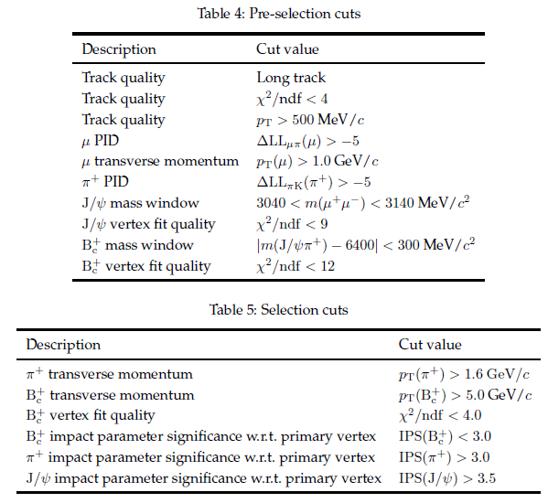
Bc selection

Slide 39
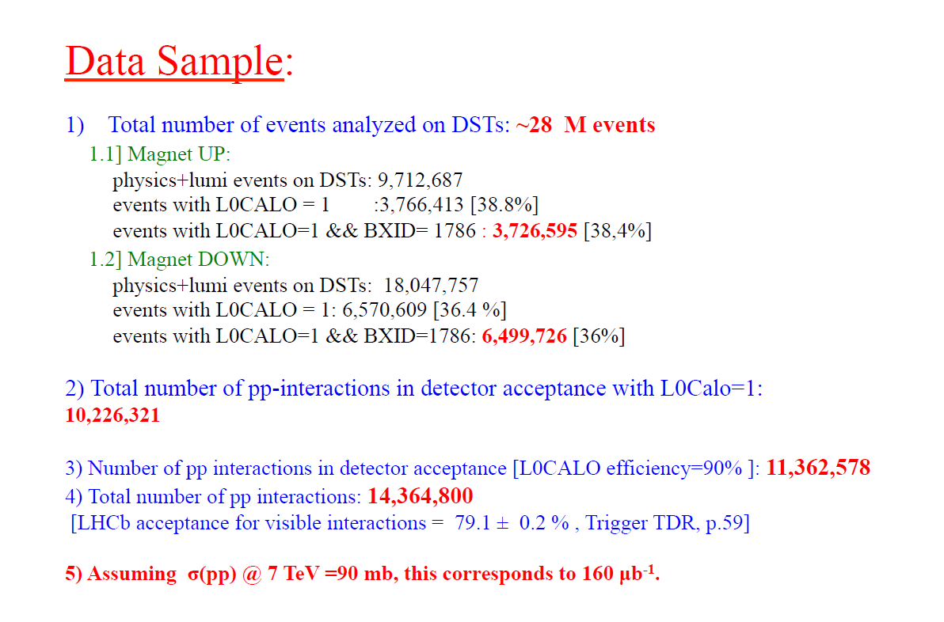

Slide 40
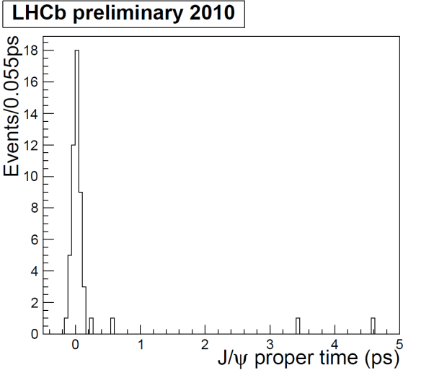
Info on B candidate
Leroy, Ruf et al.
Studies of J/ψ vertices in sample showed
that some not consistent with PV
Example: plot of J/ψ pseudo proper-time
showing suggestion of ~ 4 non-prompt candidates
This is about the fraction we would expect from MC
(assuming the cross-sections in the MC)
Displaced candidates have been scanned in Panoramix, to check in particular
whether vertex looks truly displaced, or whether it is in an unreconstructed PV
One event is of particular interest: 69618 12484. The J/ψ vertex has another
track well associated with it which is identified by the RICH as a good kaon
candidate. The invariant mass of the vertex is 5315 MeV, which would be within
2 sigma of the B mass assuming the resolution in the MC. The kinematics and
topology of the event look ‘normal’. It passes the established B→J/ψK selection.
With the MC cross-sections, we would expect ~0.15 B→J/ψK events.
More details on: http://lhcb-reconstruction.web.cern.ch/lhcb-reconstruction/Panoramix/PRplots/2010/bees/
Olivier Leroy

