Slide 1
After the discovery of Higgs: Where are we going ?
Yifang Wang
Institute of High Energy Physics, Beijing
Feb. 23, 2014，Tsinghua

Slide 2
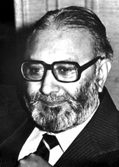
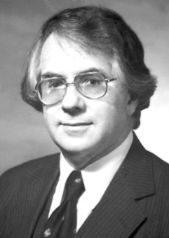
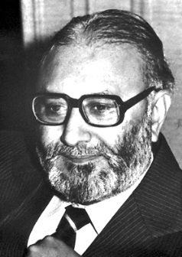
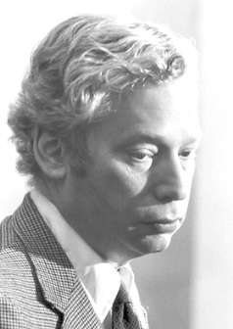
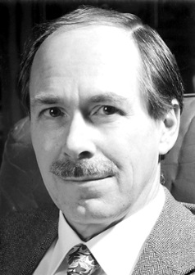
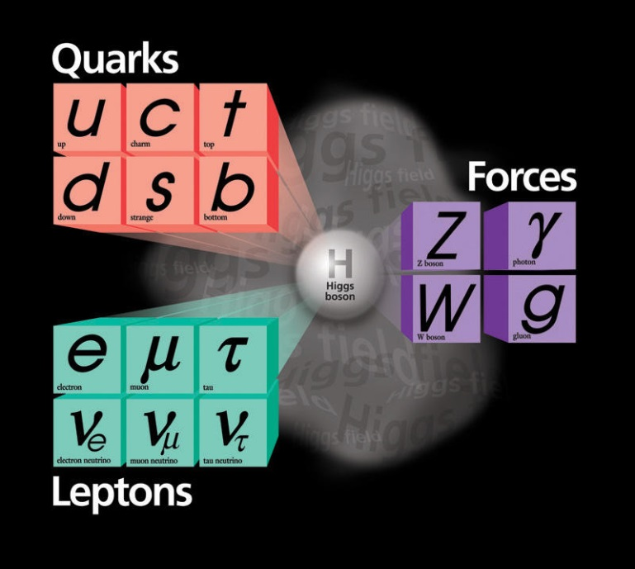
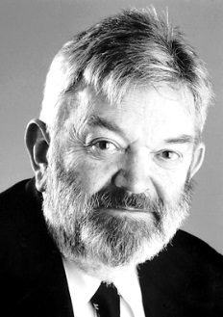
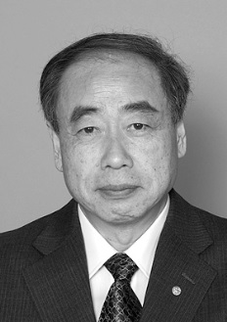
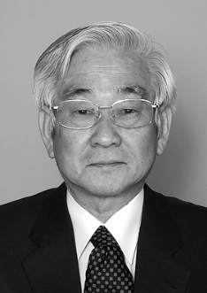
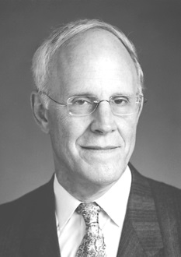
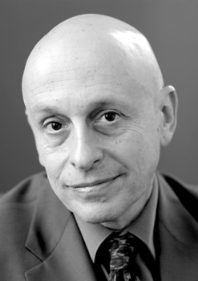
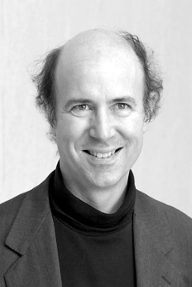
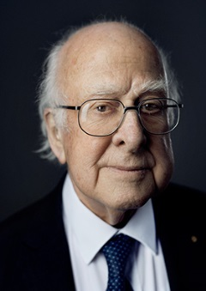
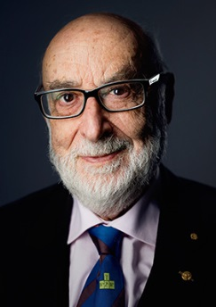
We live in a world described by the “Standard Model”

Slide 3
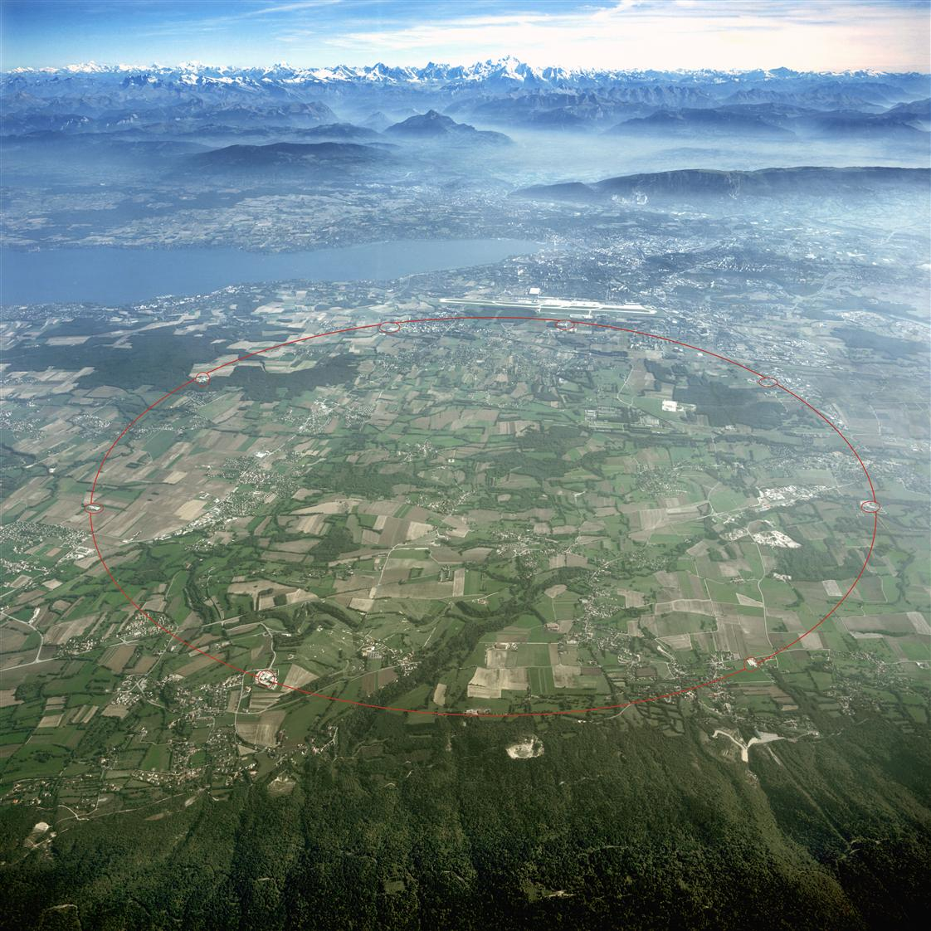
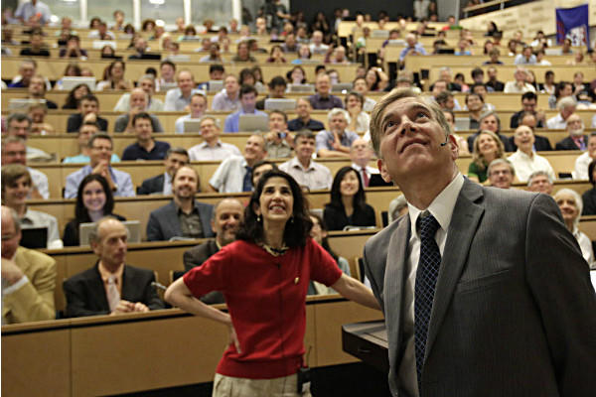
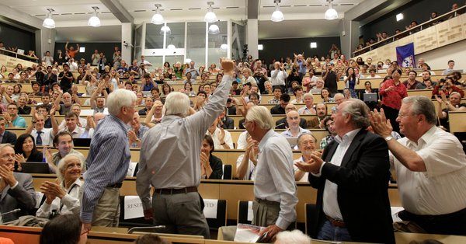
The last piece of the “Standard Model” Higgs is discovered at LHC@CERN in 2012
30 years effort by:
5 Director-General’s of CERN
Tens of thousands scientists & engineers
using/developing cutting edge technologies

Slide 4
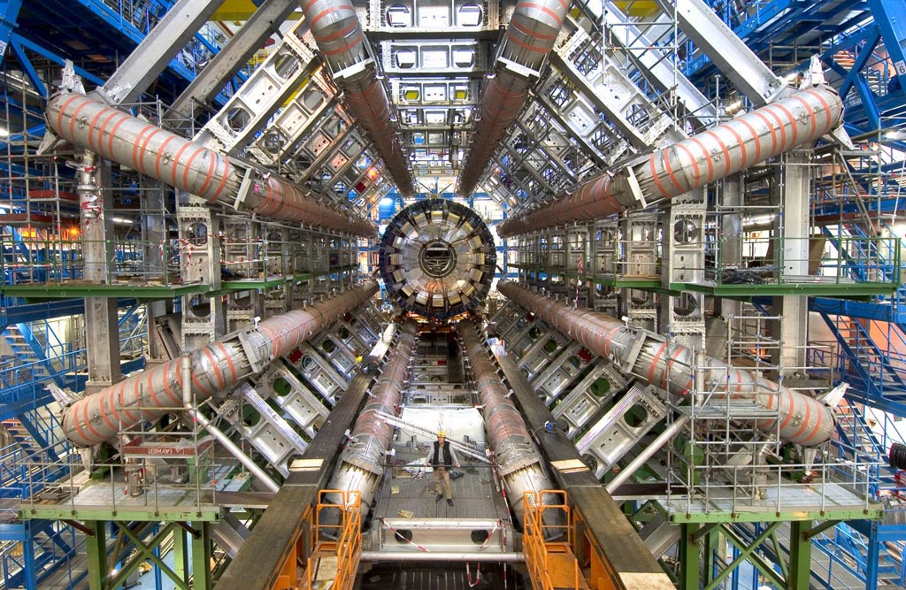
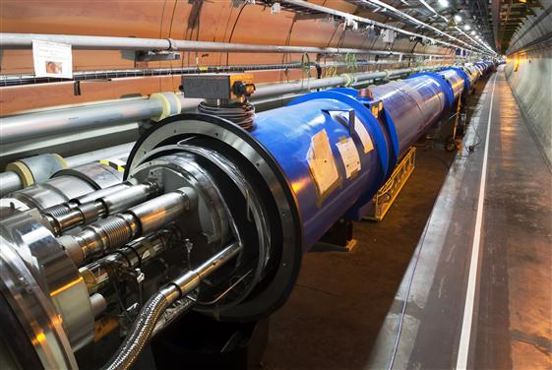
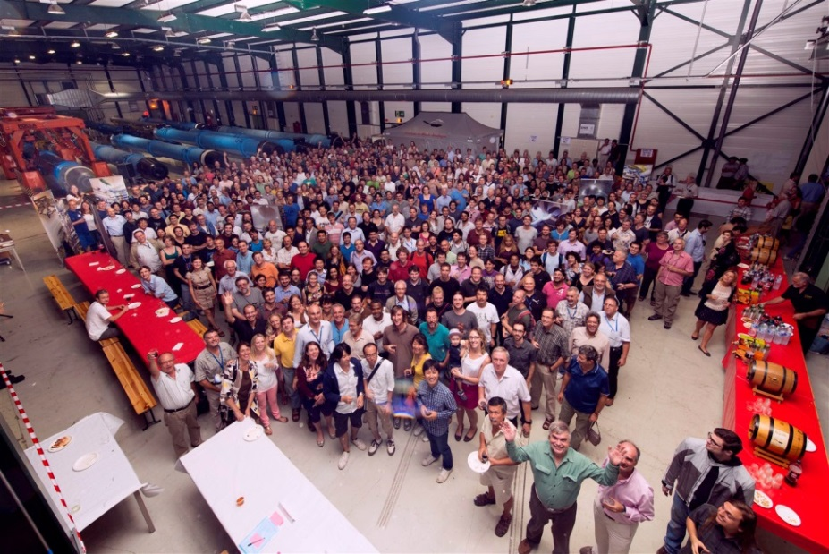
This is a global effort of collaboration, technology, organization, …
A great boost to the development of our society and people:
World-Wide-Web was invented during this process !

Slide 5
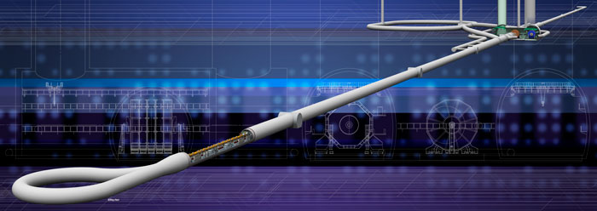
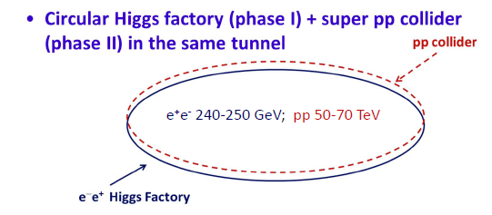
Future: where to go ?
Higher energy
Higher precision
➔ Larger accelerators
Linear colliders：ILC
Circular Colliders
Precision @ e+e- collider
Energy @ pp collider

Slide 6
CEPC+SppC
CEPC+SppC was proposed in Sep. 2012
Such a machine fits our strategic needs:
Science (great & definite physics)
Timing (after BEPCII)
Technological feasibility (experience at BEPC & LEP)
Manpower reality (our hands are free after ~2020)
Economical scale:
BEPC cost/4 y/GDP of China in 1984 ≈ 0.0001
SSC cost/10y/GDP of US in 1992 ≈ 0.0001
LEP cost/8y/GDP of EU in 1984 ≈ 0.0002
LHC cost/10y/GDP of EU in 2004 ≈ 0.0003
ILC cost/8y/GDP of Japan in 2018 ≈ 0.0002
CEPC cost/6y/GDP of China in 2020 ≈ 0.00005
SPPC cost/6y/GDP of China in 2036 ≈ 0.0001

Slide 7
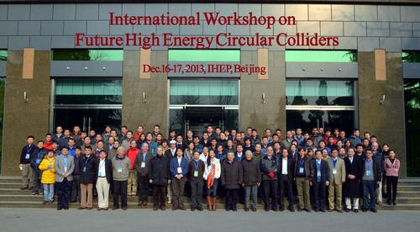
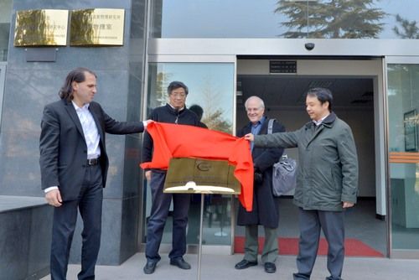
An international machine
This is a machine for the world and by the world
International kick-off meting in Dec., 2013
“Center for Future High Energy Physics (CFHEP)” is established in Dec., 2013
Prof. Nima Arkani-Hamed is the director
A seed for an international lab ➔ Organized and managed by the community
Internationalization: A road for future

Slide 8
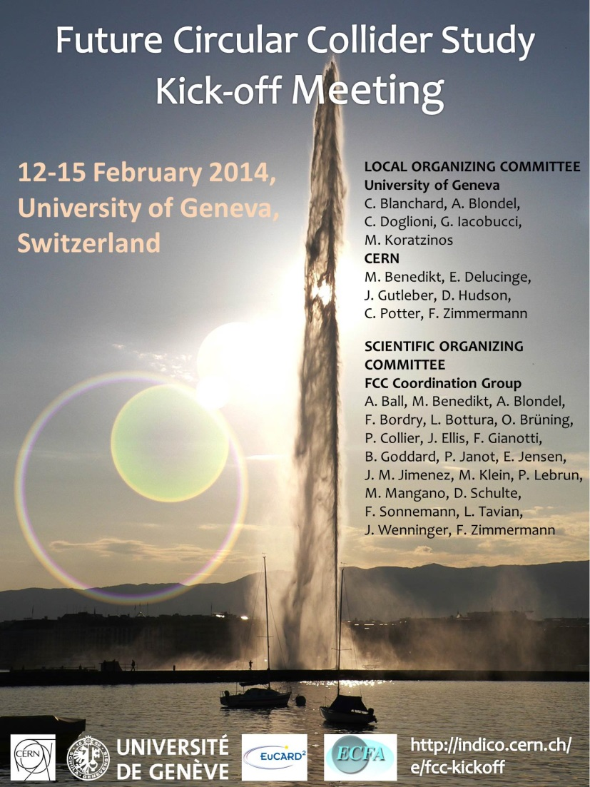
We are not alone
CERN started the Future Circular Collider effort since last year
FCC kick-off meting in Feb., 2014
ICFA statement On Feb. 21, 2014 at DESY：
ICFA supports studies of energy frontier circular colliders and encourages global coordination
ICFA: international committee for Future accelerators
http://www.fnal.gov/directorate/icfa/

Slide 9
Timeline (dream)
CPEC
Pre-study, R&D and preparation work: 2012 - 2020
Construction: 2021-2027
Data taking: 2028-2035
SppC
Pre-study, R&D and preparation work: 2012 - 2035
Construction: 2035-2042
Data taking: 2042 -
A plan for 40 years !

Slide 10
It is difficult but very exciting Let’s work for our dream

